Slide 1
Biases and their Effect on Biological Interpretation
Festival of Genomics 2017
Simon Andrews
simon.andrews@babraham.ac.uk

Slide 2
Biases
All datasets contain biases
  Technical
  Biological
  Statistical
Biases can lead to incorrect conclusions
We should be trying to spot these
  Some are more obvious than others!

Slide 3
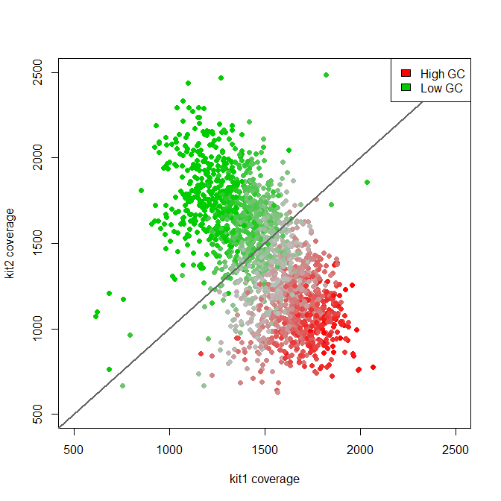
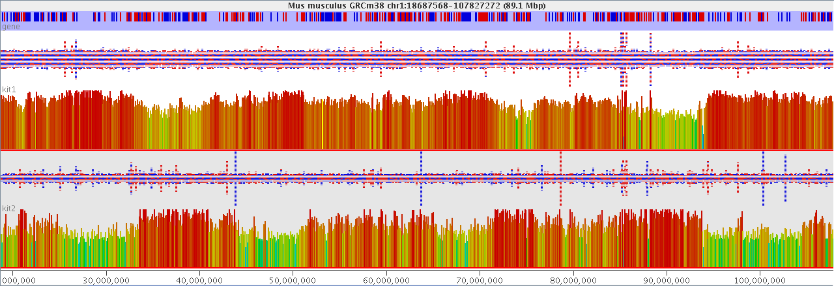
Technical Biases
Simple GC bias from different polymerases in PCR

Slide 4
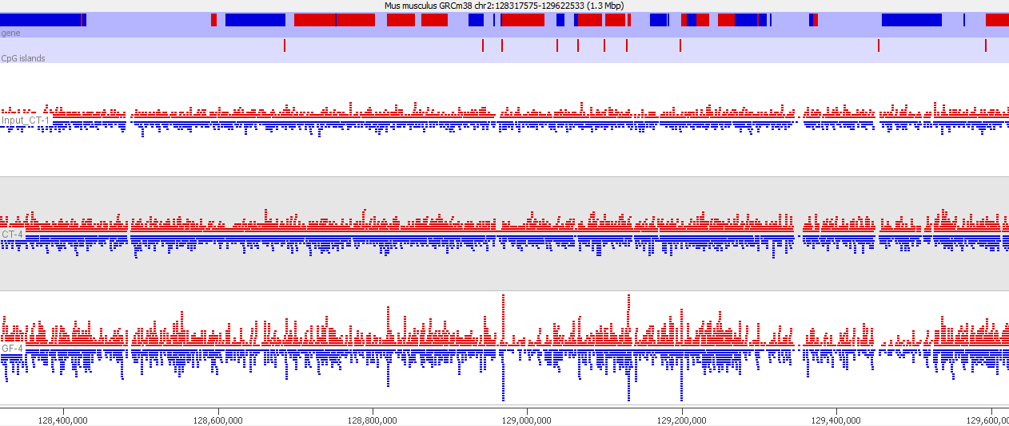
Technical Bias

Slide 5
Technical Biases
Mass Spec Data
  Membrane proteins underrepresented
    Hydrophobic
    Lipid Environment

Slide 6
Statistical Biases
The power to detect a significant effect is based on:
  How big the change is
  How well observed the data is (sample size)
Lists of hits are often biased based on statistical power

Slide 7
RNA-Seq Statistical Biases
What determines whether a gene is identified as
significantly differentially regulated?
  The amount of change (fold change)
  The variability
  How well observed was it
    How much sequencing was done overall?
    How highly expressed was the gene?
    How long was the gene?
    How mappable was the gene?

Slide 8
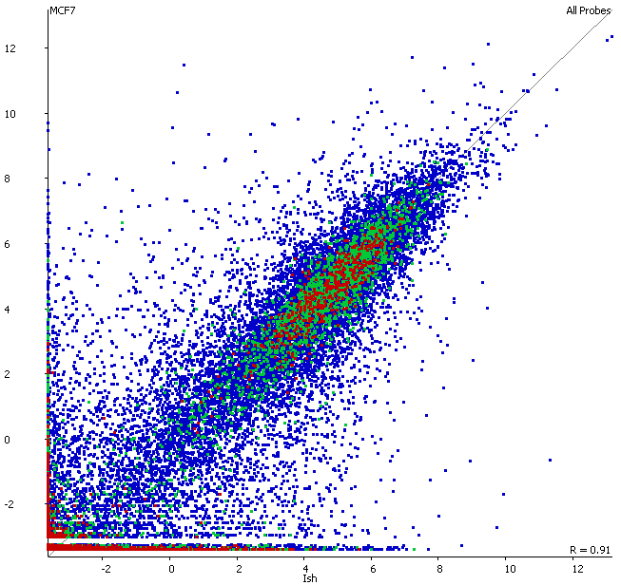
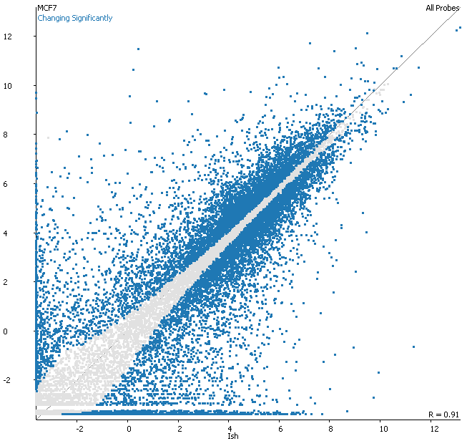
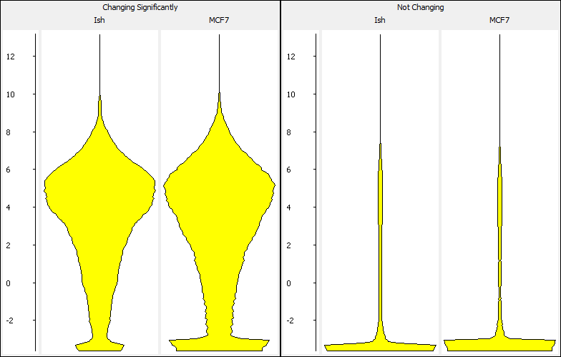
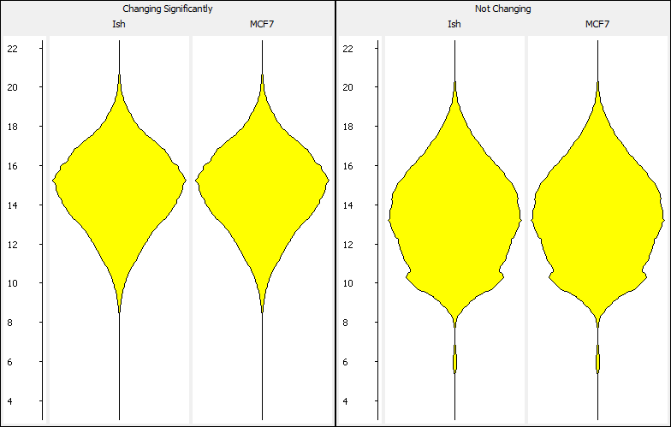
RNA-Seq Statistical Biases

Slide 9
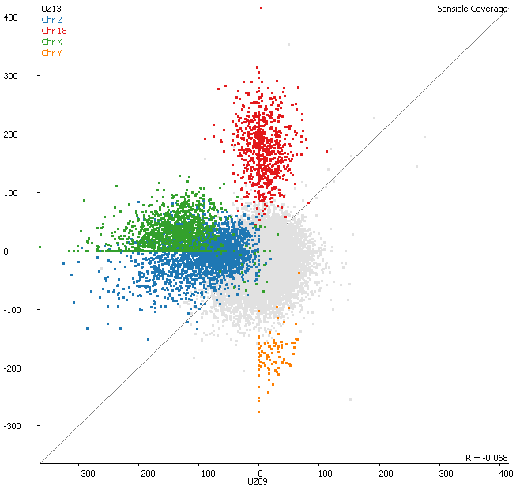
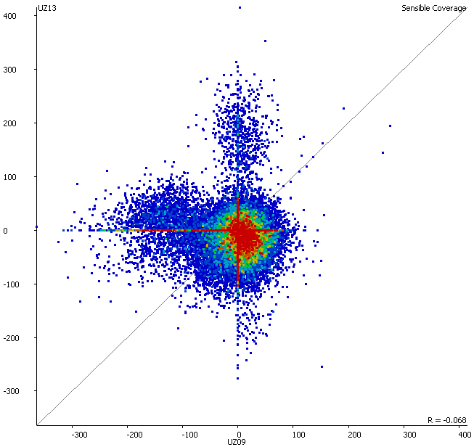
Biological Biases

Slide 10
Biases Look Like Real Biology

Slide 11
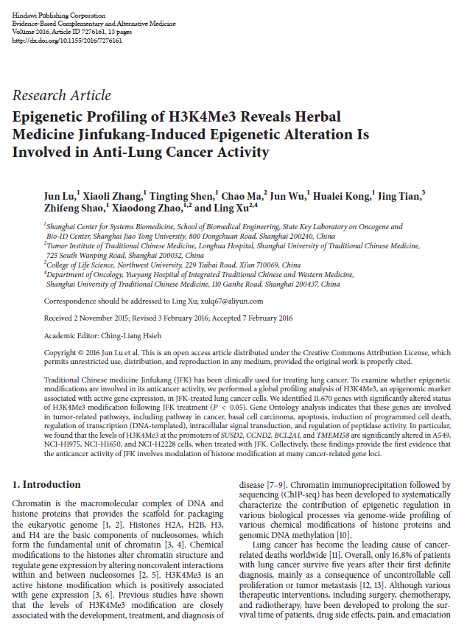

Slide 12
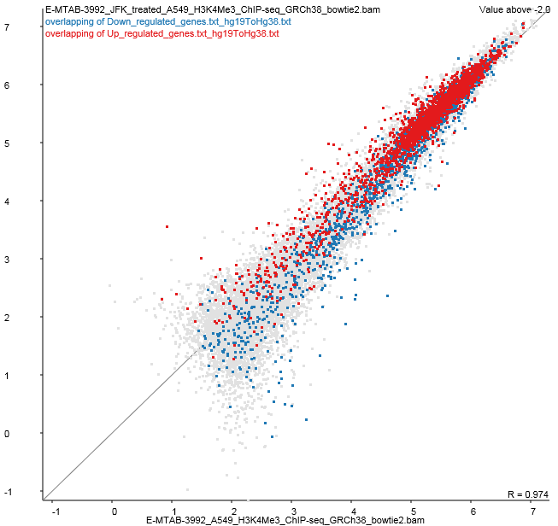
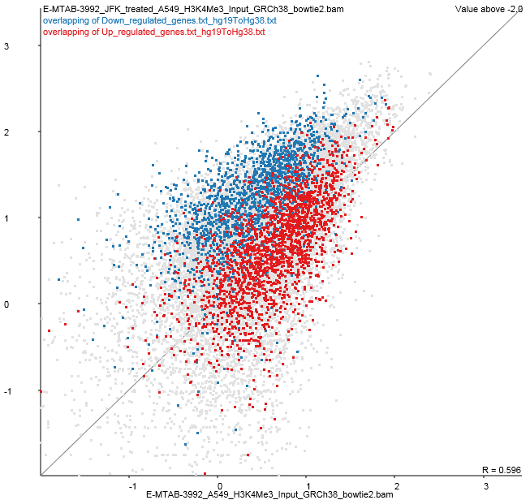
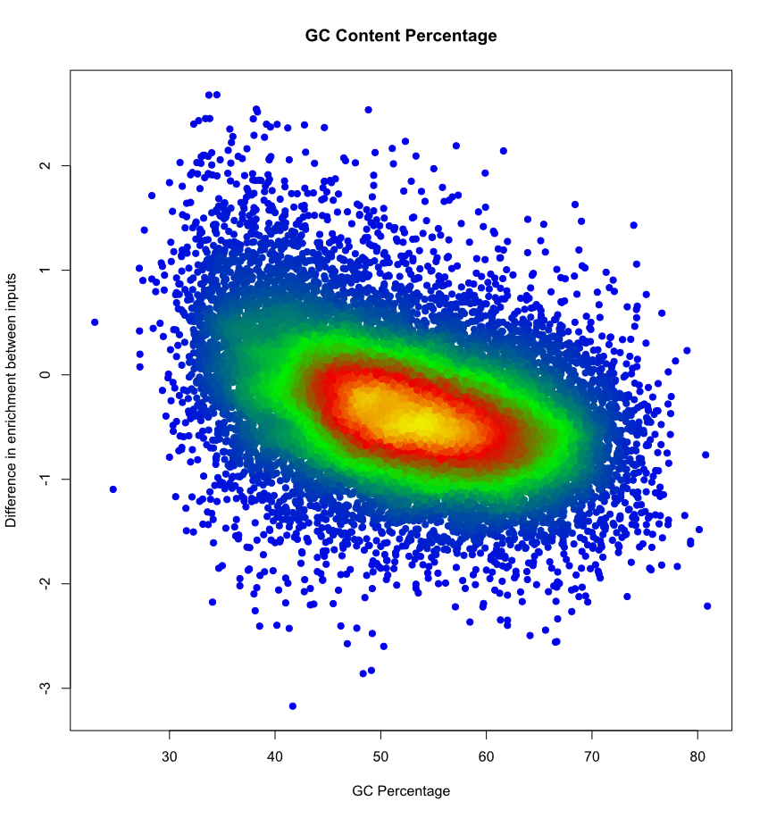

Slide 13
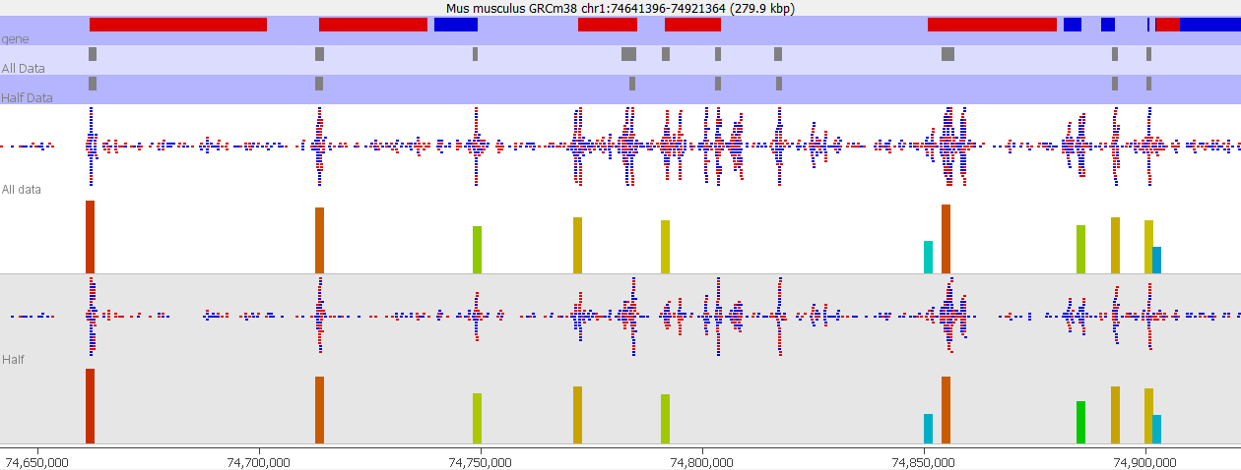
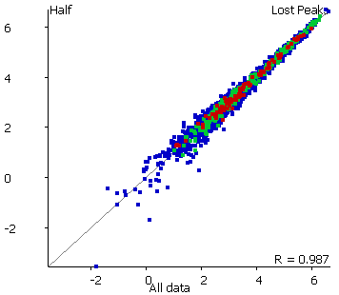
Not Significant = Not Changing
GO: Developmental Protein p=7.8e-8

Slide 14
Relating Hits to Genes
Most functional analysis is done at the gene level
  Gene Ontology
  Pathways
  Interactions
Many hits are not gene based
Power differences can affect this too

Slide 15
Random Genomic Positions
Find closest gene
  Synapse, Cell Junction, postsynaptic membrane (p=8.9e-12)
  Membrane (p=4.3e-13)
  Glycoprotein (p=1.3e-12)
Find overlapping genes
  Plekstrin homology domain (p=1.8e-7)
  Ion transport (p=7.1e-7)
  ATP-binding (p=3.8e-8)

Slide 16
Random Transcripts
Tends to favour genes with more splice variants
  Metal Binding, Zinc Finger (p=4.4e-12)
  Nucleus, Transcription Regulation (p=2.4e-14)

Slide 17
Identifying and Correcting Biases
Address biases during:
  Planning
  Quantitation
  Initial exploration
  Hit validation
  GO/Pathway Analysis

Slide 18
Minimising Bias
Can I adjust my analysis to minimise bias?
Fixed Size Windows
  Biased towards higher coverage
  Biased by CpG density
  Favours CpG islands
  Misses many real hits
Fixed Data Windows
  Even noise profile
  Even statistical power
  Uneven resolution
  Easier to interpret
  Misses fewer hits

Slide 19
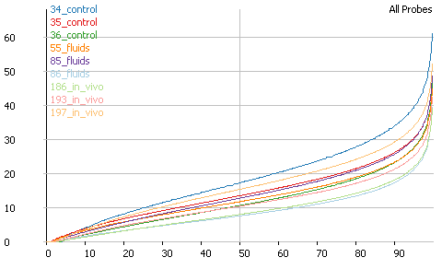
Normalising / Regression
Maths can fix my data!
Understand first
Minimal correction
Loss of interpretability

Slide 20
Hit Validation
Do my hits look different from non-hits in factors which should be unrelated
How easy would it be for the effect I see to be generated through a technical artefact?

Slide 21
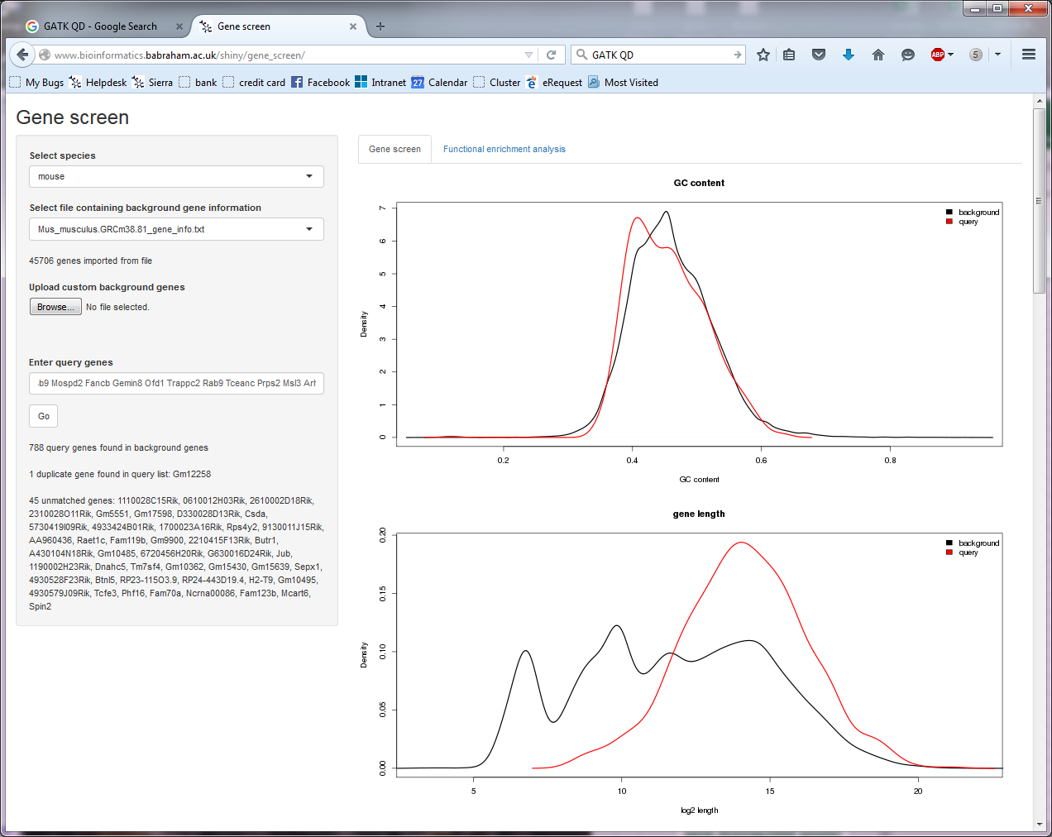
Look for confounders

Slide 22
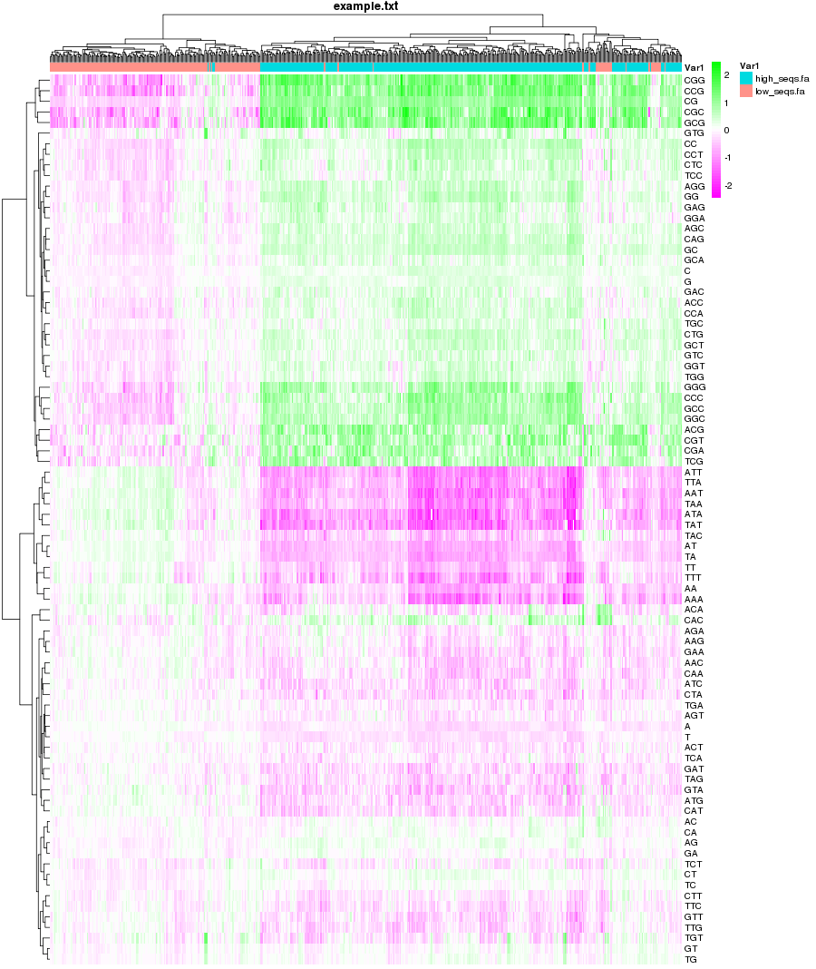
Look for confounders
Compter
  Sequence kmer analysis
  Does composition explain my hits?
www.bioinformatics.babraham.ac.uk/projects/compter

Slide 23
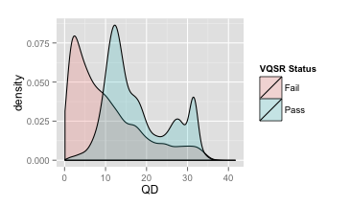
SNP Filtering
Factors to consider
  Depth of coverage
  Base call Quality
  Mapping Quality
  Position within read
  Strand bias
  Genomic Position
Types of problem
  Too low OR high
  Different to non-hits
    Error
    Bias
    Biology

Slide 24
GO / Pathway Analysis
Make sure you’re asking the right question
Background models are key
  What is different between hits and genome
  What is different between actual hits and possible hits

